Slide 1
Improving Care with a New Care Management Paradigm
Verified Outcomes Utilizing Proprietary Technology and Efficient Monitoring Methodologies

Slide 2
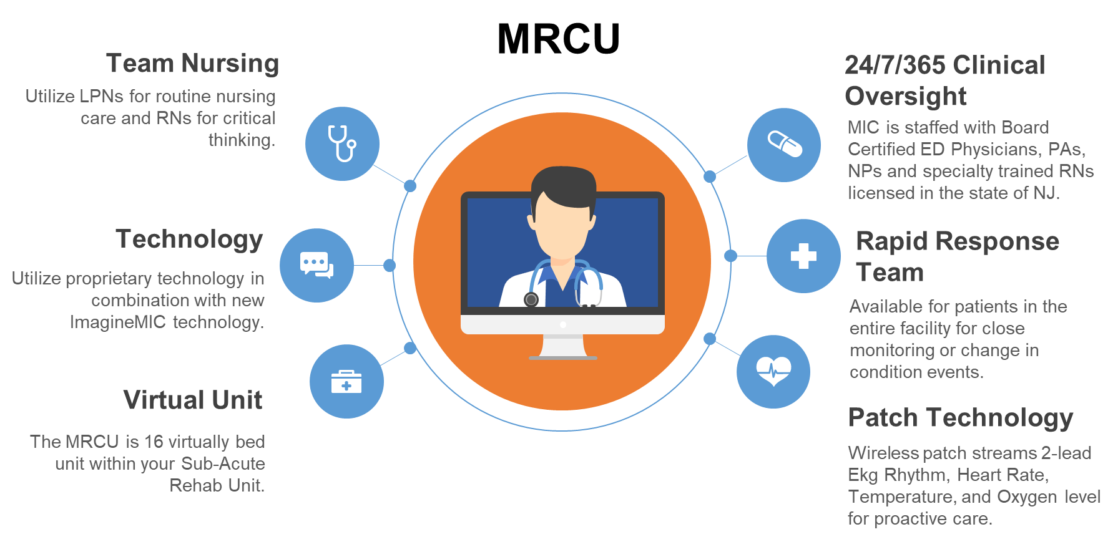
ImagineMIC™ Restorative Care Unit (MRCU)
In the SNF, the MRCU delivers verified outcomes via a cost-effective model utilizing enhanced proprietary technology and continuous clinical oversight. The Monitoring Intervention Center (MIC) is staffed 24/7/365 with an interdisciplinary care team.

Slide 3
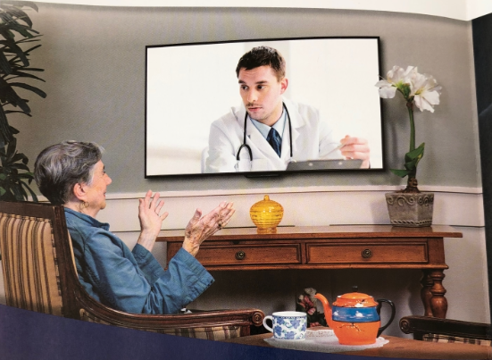
A New Chronic Care Management Paradigm
MonitorMe™ Provides Continuous Monitoring
at Home
Using proprietary patch technology, along with our Monitoring Intervention Center (MIC), our clinicians will continually monitor community-based residents at home remotely.
The Monitoring Intervention Center (MIC), located within our corporate headquarters, is a unit staffed 24/7/365 by Board Certified ER Physicians, PAs, NPs and specialty trained RNs
Proprietary FDA cleared patch technology streams real-time hemodynamic data to the clinicians in the MIC.
Cyber-secure, proprietary telemedicine devices, in the home, allows for immediate audio-visual intervention between an individual and clinicians within the MIC.

Slide 4
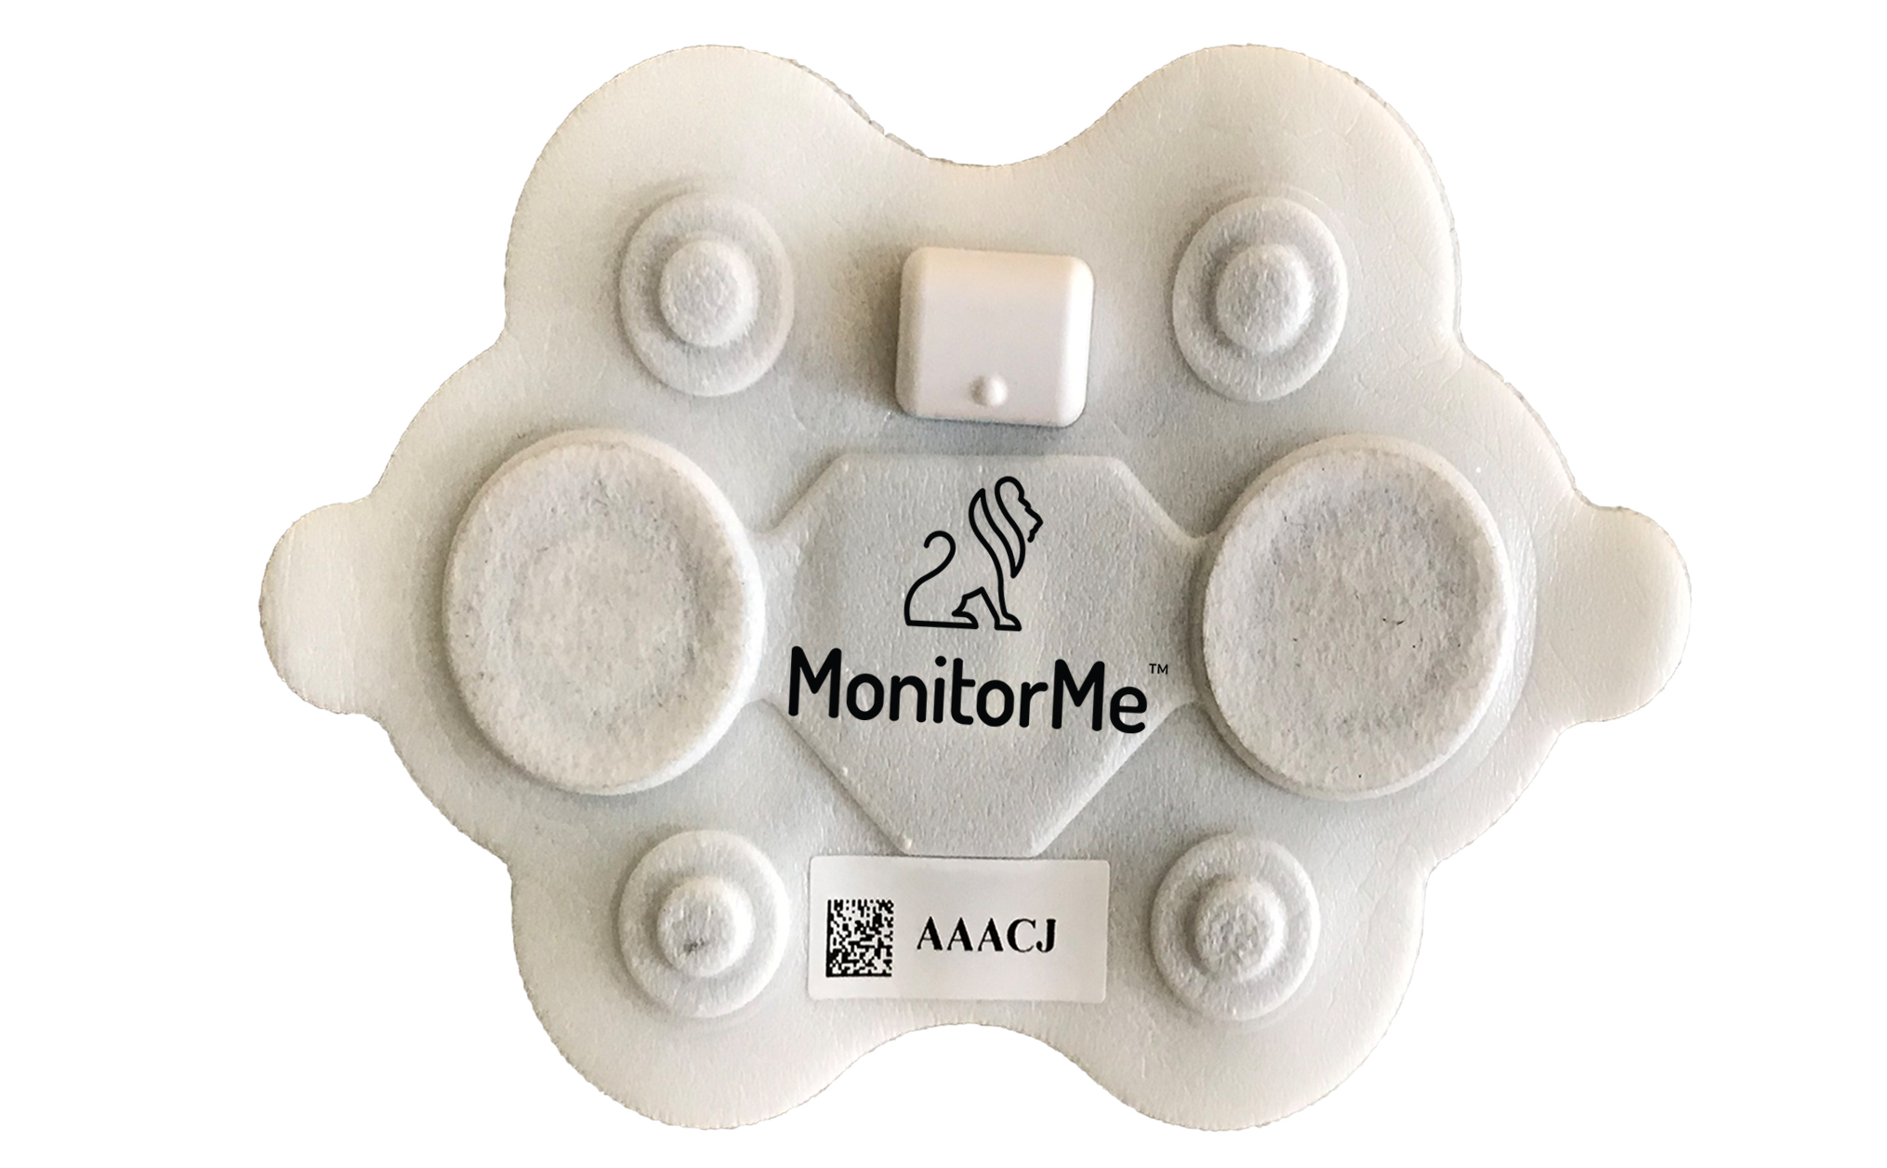
The MonitorMe™ Remote Monitoring Patch
A small, proprietary, FDA-cleared, water-resistant, hypoallergenic patch containing several biosensors is placed on the chest.
This device sends multiple hemodynamic signals in real time to the Monitoring Intervention Center (MIC).
Physical Characteristics
Approx Dimensions: 10cm X 8cm
Weight: 18gm
Heart Rate
2-Lead EKG
Respiratory Rate
Additional available Bluetooth devices:
Blood Pressure
Oxygen
Weight
Blood Glucose

Slide 5
The Next Generation of Care Management in the Home
Individuals residing at home are supplied with proprietary technology that includes a tablet, patches, gateway, and other peripheral devices which live stream hemodynamic information automatically to the MIC. Does not require self reporting of data to the MIC.
Location Agnostic: The tablet allows an individual to have immediate, HIPAA compliant, cyber-secure audio-visual communication with the MIC 24/7/365 with a simple press of one button, spanning rural-urban settings.
Day or night, our patches relay early signs of decompensation to our MIC. Our MIC clinicians can discuss care directly allowing for proactive, rather than reactive, immediate clinical interventions.
The Monitoring Intervention Center (MIC) is a unit staffed 24/7/365 by Board Certified ER Physicians, PAs, NPs, Mental Health Clinicians and specialty trained RNs all located within our corporate headquarters and licensed in the State of New Jersey.
The MIC can consult with Clinical Staff regarding all treatment plans and subsequent follow-ups.

Slide 6
Benefits of MonitorMe™ Care Management Paradigm
24/7/365 Monitoring: Now every heartbeat is captured, monitored and trended along with other pertinent hemodynamic information every minute, every hour of the day by a highly trained clinical team .
Proactive approach: This sentinel monitoring provides a true proactive approach to care management resulting in measurable improvements in the following major cost drivers:
Reduction in avoidable hospital admissions and Total Cost of Care
Access to care 24/7/365
Avoidance of unnecessary utilization of emergency medical services, including transportation
Medication compliance
Decreasing social isolation
Improved quality metrics and better patient outcomes for COPD¹, CHF², HTN³, CAD⁴, Asthma, UTI⁵, Pneumonia, Diabetes, etc.
COPD: Chronic Obstructive Pulmonary Disease
CHF: Congestive Heart Failure
HTN: Hypertension
CAD: Coronary Artery Disease
UTI: Urinary tract infection

